Slide 1






Sentiment Analysis of Airline Tweets
Presented by: Holly Figueroa
Notes:
Hello and Welcome! My name is Holly Figueroa and I will be presenting a sentiment analysis of tweets to gauge public opinions on various US airlines.

Slide 2

Analysis Questions
Can a model predict customer sentiment accurately?
What do customers complain about most?
What airline gets the most positive sentiment?
What airline gets the most negative sentiment?
Designed by FreePik
Notes:
The overall purpose of this project is to build and test a model that can gain insights of public opinions by interpreting social media posts. In addition to modeling, this project will examine data to see what customers complain about the most, what airlines get the best feedback, and what airlines get the worst. Before diving into these questions I’d like to take a moment to discuss why using social media posts, like twitter, can be an asset for business strategy.

Slide 3





Benefits of Tweet Analysis
Cost /labor effective
Potential for large sample
Potential for day-today monitoring
Competitor research
Notes:
Customer opinions have always been useful for businesses seeking to compete and improve. The airline industry is especially competitive when it comes to attracting and retaining customers. Gathering opinions through surveys, hotlines, and focus groups takes a lot of labor and funds. It takes labor, money, and time to design, distribute, and analyze a survey. While requesting tweets is not free, it’s predictable and once a model is created, it can be used in the future and improved upon. Second, businesses gain access to a much larger potential sample much easier. Third, a business can use sentiment analysis to examine real-time changes either day to day or as significant events or disruptions occur, allowing brands to create a more informed or targeted response. Finally, social media is a great avenue to gain access to competitor performance. Here businesses can identify competitive advantages or strategies to attract more customers.

Slide 4
Dataset Source and Features
14,640 Tweets from kaggle.com
Labels for Positive/Negative/Neutral
4 of 15 Variables Used in Analysis
Variable | Example
Tweet | “Flight attendants have nothing but attitude! @United”
Sentiment | Positive
Airline | United
Reason | Flight Attendant Complaint
Notes:
The data set which was sourced from kaggle.com included 14,640 tweets and a total of 15 columns, including sentiment labels. These labels were attained through a consensus panel and each label was offered with a confidence score reflecting the ratio of agreement within the panel. The set also included variables for username, timezone, time posted, but the majority were unsused. Of the 15 included variables, 4 were used including: The tweets themselves, the Sentiment label, the Airline, and the Reason for Negative Tweet.

Slide 5
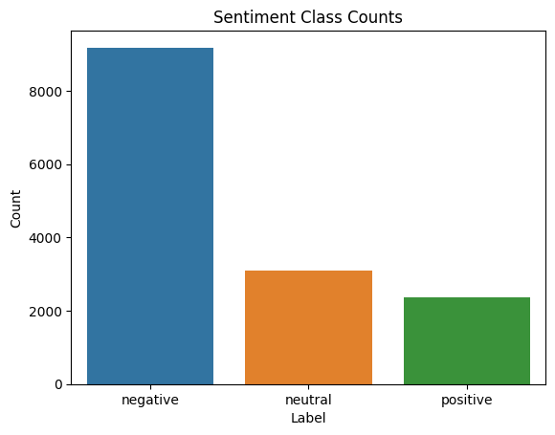
Exploratory Analysis: Target Class Distribution
Imbalanced Sentiment Classes
Over 3x Negative than Positive
3099 Neutral Removed for Modeling
Notes:
A first important step in the analysis was to look at the target class values as modeling tends to perform much better with equitable samples across labels. Here we can see that our dataset was heavily imbalanced, with over 3 times as many negative labeled tweets than positive. While this imbalance is typically concerning, the sample being over 2 thousand was still large and likely adequate for model training. So From here Airlines were explored.

Slide 6
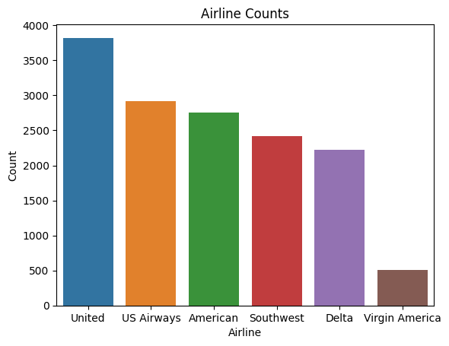
Exploratory Analysis: Distribution of Airlines
Imbalanced
Counts ranging from 504 to 3822
5 of 6 airlines with over 2k tweets
Virgin America 3x less than others
Notes:
This distribution of airlines across tweets in the dataset also shows imbalance, but this is not concerning for the purposes of training a model for sentiment. It is good to keep in mind when looking at sentiment across airlines. The distribution has counts ranging from 504 to 3822 and we can see that all but one of the airlines included have over 2 thousands related tweets in the dataset, while Virgin America airlines has 3 x less than the rest.

Slide 7
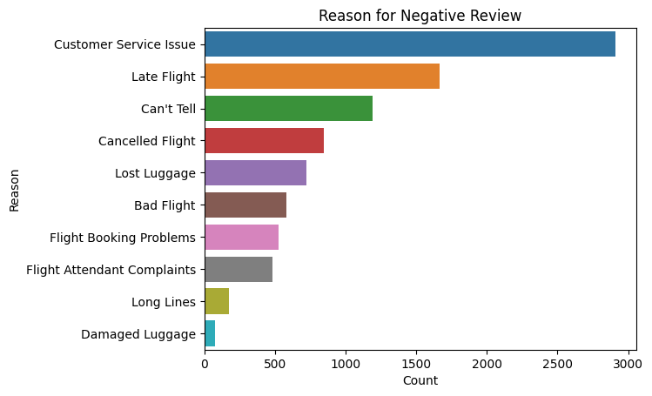
Exploratory Analysis: Negative Reviews
Counts range from 74 to 2910
Top Issue is Customer Service
1190 with uncertain reasons
Long lines and Luggage damage least common
Notes:
Now this authors of the dataset were kind enough to do the work of identifying the categorize the reasons for negative tweets and when we view how reasons are distributed we see that the most common issue was customer service followed by late flights. There is a sizable portion labeled “can’t tell” with no clear category was suggested. Finally we see that the rarest of complaints involved damaged luggage and long lines.

Slide 8
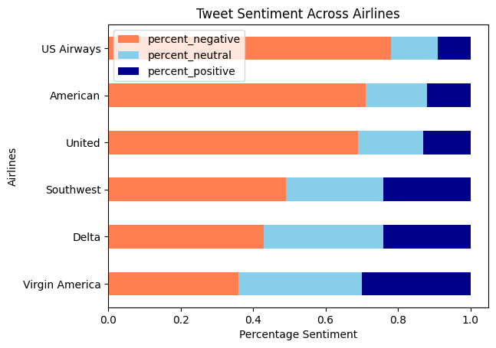
Exploratory Analysis: Comparing Airlines
Virgin America 30% positive
US Airways 9% positive
Top 2 favored Airlines also had smallest samples
Notes:
To compare sentiment types across airlines, a percentage was created from each airline review total. This allowed for a more fair comparison while considering the different sample sizes noted earlier in the presentation. This stacked bar chart of sentiment showed that Virgin America had the highest percentage of positive reviews at 30%, which if we recall had the smallest count of tweets of all the airlines. Beyond Virgin America, tweets next favored Delta at 24% positive, which had the next smallest count in the sample. Meanwhile US Airways had the lowest percentage positive tweets at 9%, and the highest percentage of negative tweets at a whopping 78%.

Slide 9

Preprocessing Tweets for Modeling
Removal of:
user handles
URLs
special characters
STOPWORDS
Tokenization
Stemming
Count Vectorization
Me and @Bestie56 are never taking @Delta again. What a terrible experience! Check out these prices! https.deltatickets/pricing/….
never | rude | take | late | terribl | experi | check | price | ! | best
1 | 0 | 1 | 0 | 1 | 1 | 1 | 1 | 1 | 0
[never, take, terribl, experi, check, price, !]
Notes:
With the variables examined, there were important steps to take to prepare tweets for modeling. First user handles were removed, then URL links people shared. Special characters were removed, but a special exception was made for exclamation points which are generally used to convey strength of opinions and it was hoped that the model make some use of including them. English stopwords were removed, which include many of the small words that tend to offer little when modeling. Short words like there/it/and/the/at/was/ etecetera. Tweets were then Tokenized to split them up into a list of words which was then stemmed which reduces a word to it’s root, without prefix or suffix. Finally to allow the model to process the text data all words from all tweets were extracted into columns where each tweet was then represented in a matrix of 1s and 0s. This illustration shows what a tweet would look like amidst other words in the matrix that weren’t included in the tweet. Typically a different method, called Tf_DF vectorization is favored with a reputation for better results, but after testing both methods, count vectorization performed better.

Slide 10
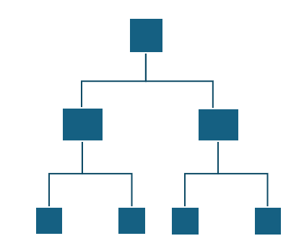

Random Forests Classification
Benefits
Less prone to overfitting
Less influenced by irrelevant features
Ensemble method that decides based on combined results of multiple trees
Positive
Positive
Negative
Majority Vote: Positive
Notes:
Once these important steps were taken the data was then split for training and testing at a ratio of 8:2 for modeling. Three models were tested, including a Random Forests Classifier which ended up with the best results. This model was chosen to be tested out because it is able to handle large datasets and is less prone to over-fitting. Because this model uses a series of decision tree models on subsets of training data, because of this, less-relevant features have less influence on the model results. This ensemble method makes it’s final decision based on the majority outcome of the tree models combined.

Slide 11
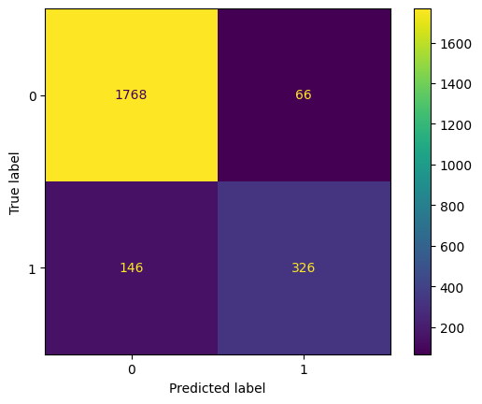
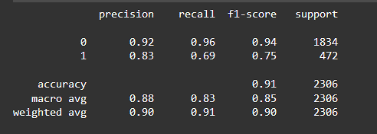
Model Evaluation
Model Accuracy 99%
Test Accuracy 91%
Notes:
The results of this model turned out well. With a model accuracy of 99% and test accuracy of 91%. Here a confusion matrix and a classification report is shared that allows a more detailed look into the model’s performance across both classes. Here we see that while the precision is high, the recall and F1 score is lower for the positive class. This suggests that the model accuracy was brought down by its ability to identify positive tweets compared to negative tweets.

